Slide 1
Hi Guru,
I would like to add a new feature to this Chrome extension.
When a DMC code is selected, in addition to displaying the MR/Route for the DMC, I would also like to display the resources required to perform the work.
The resources can be obtained using the following procedure:
1. In the “★ASY&DAS” sheet of the attached file, search the DMC in column H. (Example: PW1100G-B-73-21-66-00A-720A-D)
2. In the same row, find the value in column E. (Example for the above DMC: PW1100G.ASY_Mech_1&7.Task Card...)

Slide 2
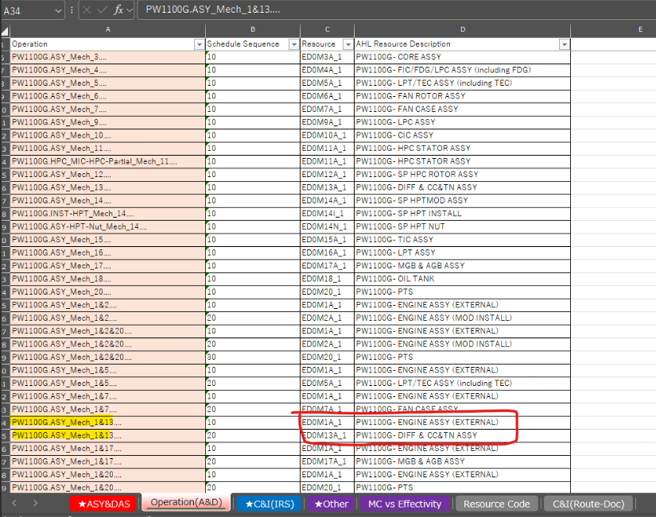
3. In the “Operation(A&D)” sheet, search for this value from column E in column A. (Example: find PW1100G.ASY_Mech_1&7.Task Card... in column A)

Slide 3
4. From the matching row in the “Operation(A&D)” sheet, I would like to display the values in columns C and D as the “resources” in the extension.
Regarding the attached file, we would like the system to select a file in an arbitrary folder by default as with the previous case.
Please let me know if any questions.
Regards,
Ryo Sato

Slide 4
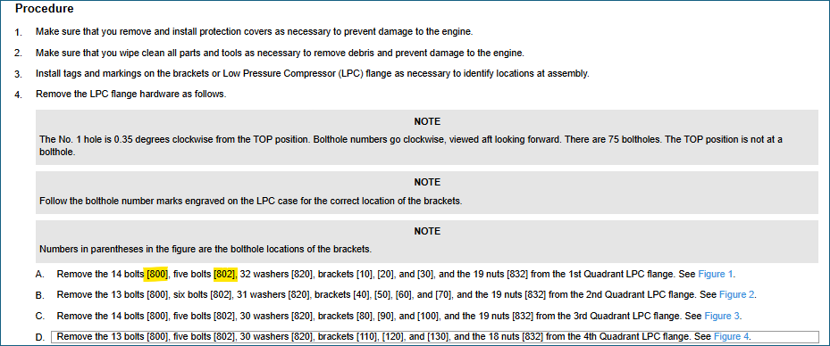
Mail -2
Hi Guru,
This request is just a feasibility check with your team.
In the disassembly and assembly tasks, item numbers are assigned to each part, but there is no link to the EIPD (e.g., the item numbers labeled [800] and [802] in the figure below).
Therefore, if possible, I would like to create another extension that can display the PN and ATA code from the EIPD when a user selects an item number in the disassembly and assembly task.
Could you check the feasibility of such a extension with your team?

